Slide 1
Uniform circular motion
Centripetal and Centrifugal force

Slide 2
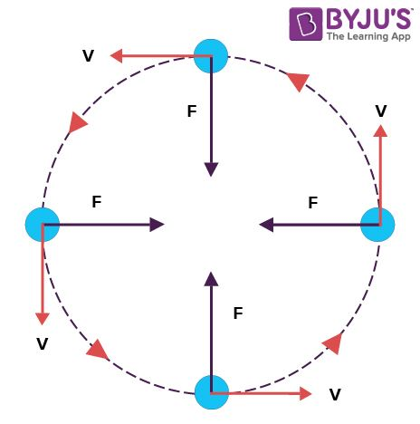
Uniform Circular motion
The motion of a body around a circular path with uniform speed, but variable velocity, such that it is acted upon by a uniform acceleration is called circular motion.

Slide 3
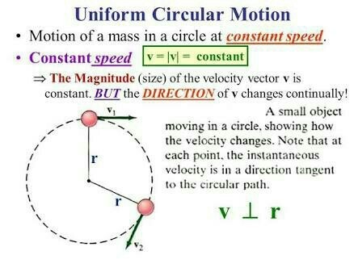
Reference video links for uniform circular motion
https://www.youtube.com/watch?v=y2FmgoOht7Y&feature=youtu.be
https://www.youtube.com/watch?v=CzcmUiD39VI&feature=youtu.be

Slide 4
Centripetal Force
When a body moves along a circular path with a uniform speed, it covers equal distances in equal intervals of time, but its direction changes at every point.
In order to move along the circular path, the body must be under the action of some external force.
If this external force acts at right angles to the direction of motion of the body at all points along the circular path and has no component in the direction of motion to change its speed.
The magnitude of centripetal force is given by the expression F= mv²/r, where v is uniform speed along the circular path and r is the radius.

Slide 5
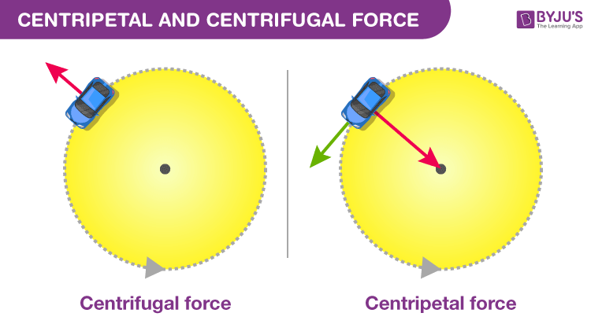
Centripetal force examples
Spinning a ball on a string or twirling a lasso: Here the centripetal force is provided by the force of tension on the rope pulls the object in toward the centre.
Turning a car: Here the centripetal force is provided by the frictional force between the ground and the wheels.
Going through a loop on a roller coaster: The force is provided by the Normal Force as the seat or wall pushes you toward the centre.
Planets orbiting around the Sun: Centripetal Force is provided by Gravity.
A planet moves around the sun in a circular path for which the gravitational force of attraction on the planet b the Sun provides the necessary centripetal force.
The moon revolves around the earth in a circular path for which the gravitational force of attraction on the moon by the earth provides the centripetal force.

Slide 6
Centrifugal force
A force assumed by an observer moving with the body to act on the body in direction away from the centre of circular path, is called the centrifugal force.
But the centrifugal force is not the force of reaction of the centripetal force because action and reaction do not act on the same body.
It is not real force, but it is fictitious force assumed by an observer moving in circular path along with the body.

Slide 7
Important properties of Centrifugal force
The centrifugal force is not a real force, it is a fictitious force.
A force which really does not exist, but is considered to describe a certain motion, is called a fictitious force.
Reference videos for centripetal and centrifugal force
https://www.youtube.com/watch?v=KvCezk9DJfk&feature=youtu.be
https://www.youtube.com/watch?v=0L-foX49Row

Slide 8
Centrifugal Force Examples
Centrifugal Force acts on every object moving in a circular path when viewed from a rotating frame of reference. Some examples of Centrifugal Force are given below.
Weight of an object at the poles and on the equator
A bike making a turn.
Vehicle driving around a curve
Equatorial railway

Slide 9
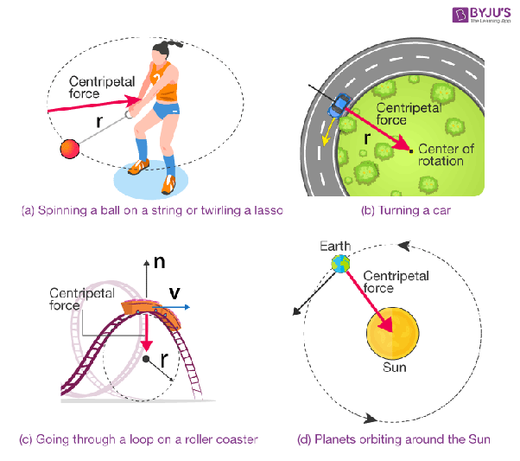

Slide 10
Instructions for the students
Exercise Questions to be done in notebook
Q16, Q17, Q18
Comparison between Centripetal and Centrifugal Force.
Pages to be read from the book – Pages 8, 9 and 10

